Slide 1
Basics of DBMS

Slide 2
DBMS
Database Management System
Term Database requires understanding of data and information

Slide 3
Difference between Data and Information?

Slide 4
Is the following text data or information?
INT 306
Data
Information

Slide 5
Course code- INT 306
a) data
b) Information

Slide 6
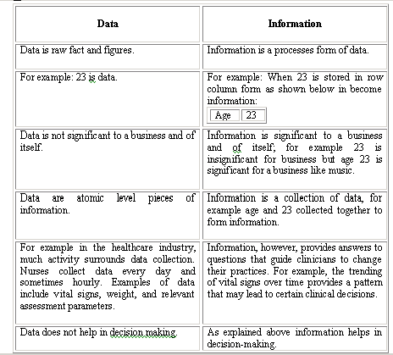

Slide 7
Database
The related information when placed in an organized form makes a database. The organization of data/information is necessary because unorganized information has no meaning.

Slide 8
Operations on Databases
To add new information
To view or retrieve the stored information
To modify or edit the existing
To remove or delete the unwanted information
Arranging the information in a desired order etc.

Slide 9
Manual database and its problems
Wastage of
skills and
intelligence
of human
beings on
repetitive calculations.
Error prone.

Slide 10
Database and Computers
•Large storage capacity
•It has high speed
•Computer is more accurate.
•There are two approaches for storing data in computers such as File based approach and Database approach.

Slide 11
File Based Approach
A file system is a method for storing and organizing computer files
File systems may use a storage device such as a hard disk or CD-ROM and involve maintaining the physical location of the files.
Programmers used programming languages such as COBOL, C++ to write applications that directly accessed flat files to perform data management services and provide information for users.

Slide 12
Limitations of the File-Based Approach
Separated and Isolated Data
Duplication of data
Data Dependence
Difficulty in representing data from the user’s view
Data Inflexibility
Incompatible file formats

Slide 13
Database Approach
A database is a computer based record keeping system whose over all purpose is to record and maintain information. The database is a single, large repository of data, which can be used simultaneously by many departments and users.

Slide 14
Database Management System (DBMS)
DBMS A database management system is the software system that allows users to define, create and maintain a database and provides controlled access to the data.
A database management system (DBMS) is basically a collection of programs that enables users to store, modify, and extract information from a database as per the requirements.

Slide 15
Ques- Tuple is another name for
Row
Column

Slide 16
Examples of Database Applications
The following are main examples of database applications:
Computerized library systems
Automated teller machines
Flight reservation systems
Computerized parts inventory systems
Commercially available Database management systems in the market are dbase, Foxpro, IMS and Oracle.

Slide 17
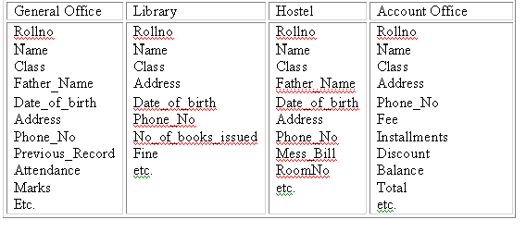
University Database in File Based System

Slide 18
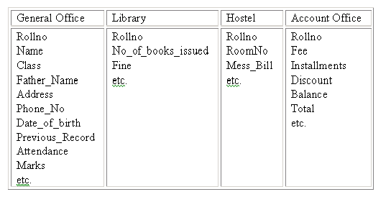
University Database in Database based System

Slide 19
Advantages of DBMS

Slide 20
Controlling redundancy
Data redundancy is a condition created within a database or data storage technology in which the same piece of data is held in two separate places.

Slide 21
Integrity can be enforced
Integrity of data means that data in database is always accurate, such that incorrect information cannot be stored in database.

Slide 22
Inconsistency can be avoided
When the same data is duplicated and changes are made at one site, which is not propagated to the other site, it gives rise to inconsistency and the two entries regarding the same data will not agree.

Slide 23
Other Advantages
Data can be shared
Providing Backup and Recovery
Restricting unauthorized access
Solving enterprise requirement than individual requirement

Slide 24
Disadvantages of DBMS
Complexity
Size
Performance
Higher impact of a failure
Cost of DBMS
Additional Hardware costs
Cost of Conversion

Slide 25
Applications of DBMS
Banking: all transactions
Airlines: reservations, schedules
Universities: registration, grades
Sales: customers, products, purchases
Online retailers: order tracking, customized recommendations
Manufacturing: production, inventory, orders, supply chain
Human resources: employee records, salaries, tax deductions

Slide 26
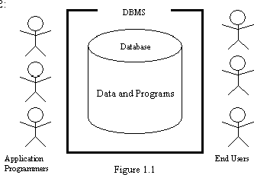
Components of the DBMS Environment
•Hardware
•Software
•Data
•Users
Procedures

Slide 27
Hardware: Computer system used for keeping and accessing the database
Software: The actual DBMS
    Allows user to communicate with the database
    The mediator between database and users
Data: Most important component from end users point of view
Procedures: Instructions and rules that govern design and use of the database
    Log on to the DBMS
    Start and stop the DBMS
    Make backup copies of the database
contd...

Slide 28
Users: Who can access or retrieve data on demand using applications interfaces provided by DBMS. The users can be:
Naive users
Application programmers
Sophisticated users
Database designers
Database administrators

Slide 29
Naive users- have little or no knowledge of data base
Application programmers- Back end developers
Sophisticated users- Interact with the system without writing the program, they deal directly with database. They write queries to delete or select or update or insert the database

Slide 30
Database designers- Define detailed database design including tables, views and other database constructs which are used to store and retrieve objects
Database administrators- Use software to store and organize data. E.g. Planning, Installation, Configuration, Database design, security, troubleshooting, backup and recovery

Slide 31
Question: While performing a transaction at ATM, You belong to which category of users?
Naive user
Application Programmer
Sophisticated user
Database administrator

